Slide 1
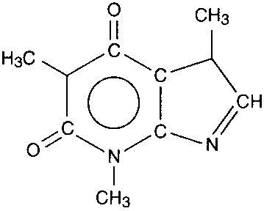
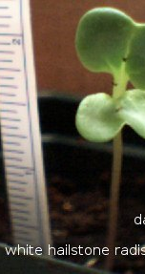
Addition of Caffeine to Soil Did Not Increase the Average Height of Radishes Compared to the Control B. Badger, W. Wolverine. Agriscience, Hour 6, Waterford Union High School.
Introduction: Radishes, like all plants, use carbon dioxide from the air and water from the soil to produce sugar through photosynthesis (Kohn, 2011). Caffeine is a compound produced naturally by some plants, including the coffee plant (Folgers, 2009). Caffeine can increase circulation rates in animals (Maxwell, 2006). We wondered if adding pure caffeine to the soil of growing radish seedlings would increase the height of the plants. We hypothesized that radishes that were given caffeine would be taller on average than radishes in the control group. We thought this would happen because a possible increased circulation of nutrients in the plant similar to how circulation is increased in animals treated with caffeine.
Results: After two weeks, we obtained the following results:
As you can see in this graph, the radishes treated with caffeine were 0.5 cm shorter on average than the plants in the control.
Discussion & Conclusion: We hypothesized that adding caffeine to the soil of radish plants would create taller radish plants. Our hypothesis was not supported by our data. While this may be correct, it may also be possible that with more time, our treated radishes might grow taller. The caffeine may need more than two weeks to react. That said, we believe that our hypothesis is most likely incorrect, as we have no evidence to support our ideas. We would have to conduct the same experiment on a much larger basis with more replicates in order to determine if this is actually the case.
A molecule of caffeine. Source: answers.com, 2011
Methods: To test this idea, we used the following steps:
Plant 12 radish seeds according to instructions on the packet.
On a daily basis, water the radishes with 100 ml of water. The six control radishes received pure water; the six experimental radishes received 5 mg of caffeine dissolved in the water.
Water and observe the radishes on a daily basis.
After two weeks, or 14 days, measure the height of each radish plant by gently stretching the plant and measuring from where the plant emerges from the soil to the highest point.
Average the height of all radishes; record those that don’t sprout as a “0”.
Bibliography:
-Answers.com. 2011. Caffeine. www.answers.com. Accessed Sept. 26, 2011.
-Folgers, C. 2009. Science of Caffeine. www.usda.gov. Accessed Sept 26, 2011.
-Kohn, Craig. 2011. Carbon Cycle (PowerPoint). Waterford Union High School – Classroom lecture.
-Maxwell, H. 2006. Impact of Caffeine on the Circulatory System. www.wisc.edu. Accessed Sept 26, 2011.
Source: curlydock.wordpress.com

